Slide 1
Global E-commercial Entity Specialized in Electronic Products
Casey Patel

Slide 2
The Problem
Identifying emerging trends in customer preferences to increase revenue

Slide 3
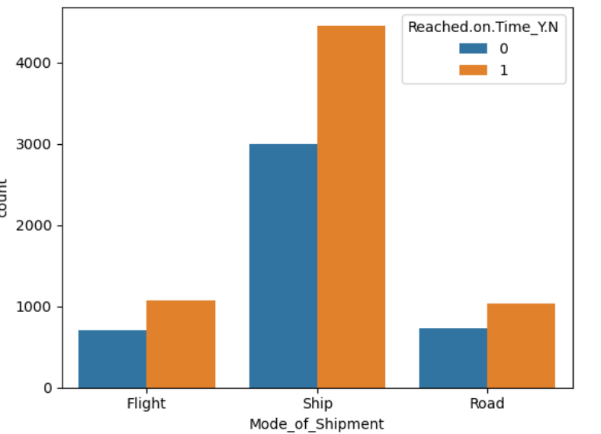
Data Wrangling
Based on the graph we can conclude that air flight is shipping faster than ship and road.
Notes:
Reached on time: It is the target variable, where 1 Indicates that the product has NOT reached on time and 0 indicates it has reached on time.

Slide 4
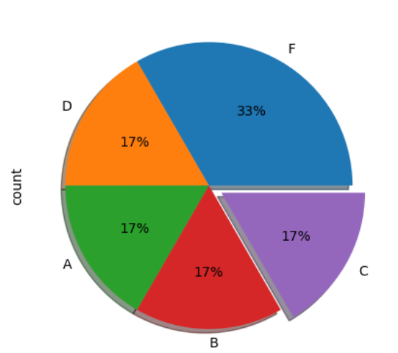
Data Wrangling
we can conclude that F distribution has optimizing efficiency and accessibility

Slide 5
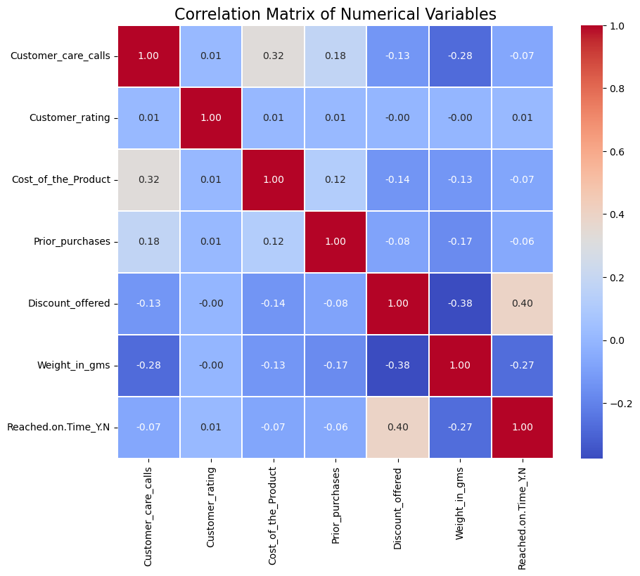
Explanatory Data Analysis
There is a positive relationship between the discount_offered and reached on time products.

Slide 6
Model Selection
Logistic Regression,
Gradient Boosting classifier,
random forest
decision tree.

Slide 7
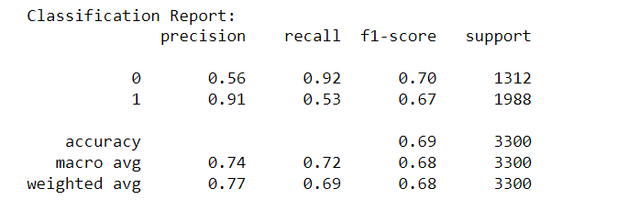
Best Model
Most variables performed best with the decision tree classifier. I was able to improve the model slightly more to 91% precision.

Slide 8
Conclusion
customers are prepared to pay a premium for products with quicker delivery options, especially if discounts applied make the overall cost more accessible.
Shipping by sea is an efficient method for transporting large quantities of goods over long distances

